Slide 1
Modern Routing algorithm
Xun Liu 09-25-2018

Slide 2
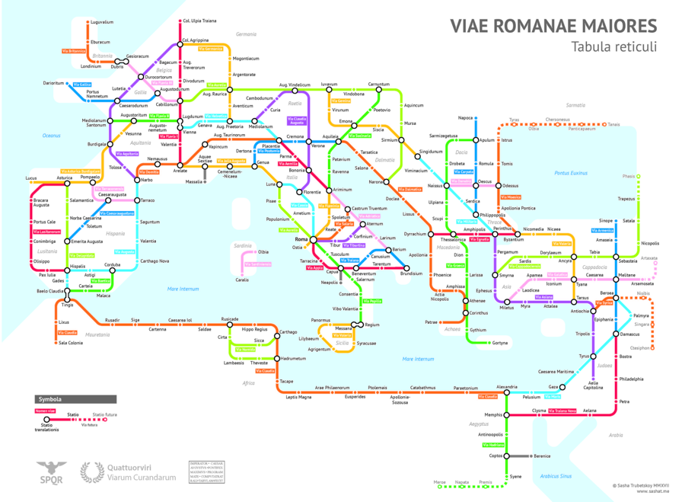
Roman Empire in the year 125AD

Slide 3
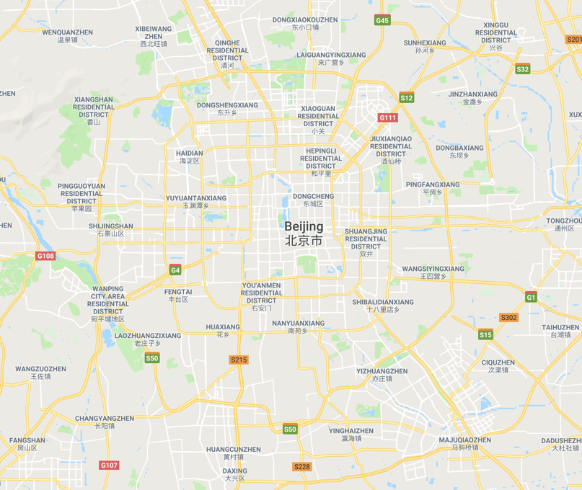

Slide 4
Routing’s requirement set
Features | Comments
Consider all detail of road network, turns
Different Metrix(cost function)
Dynamic information(live traffic)
Traffic jam, user information
Performance
Preprocessing
Mathematical correct

Slide 5
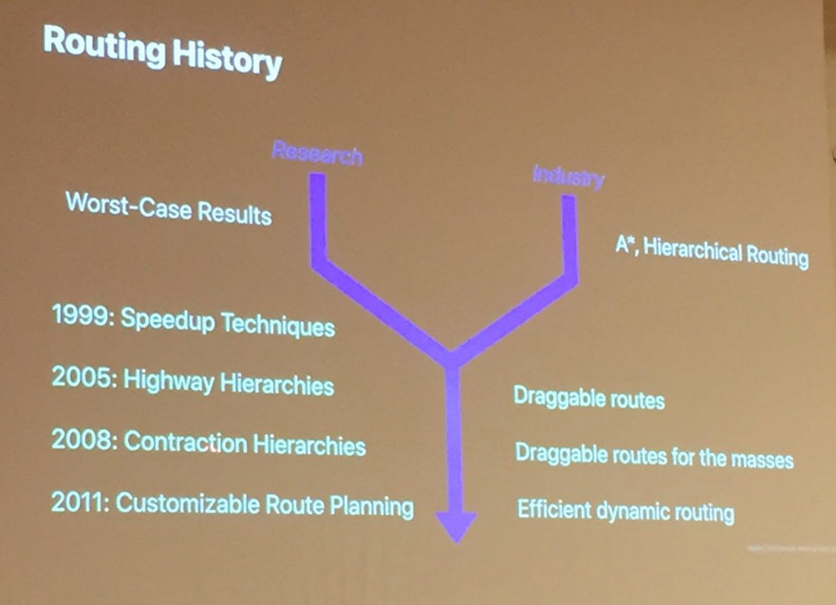
Routing in history

Slide 6
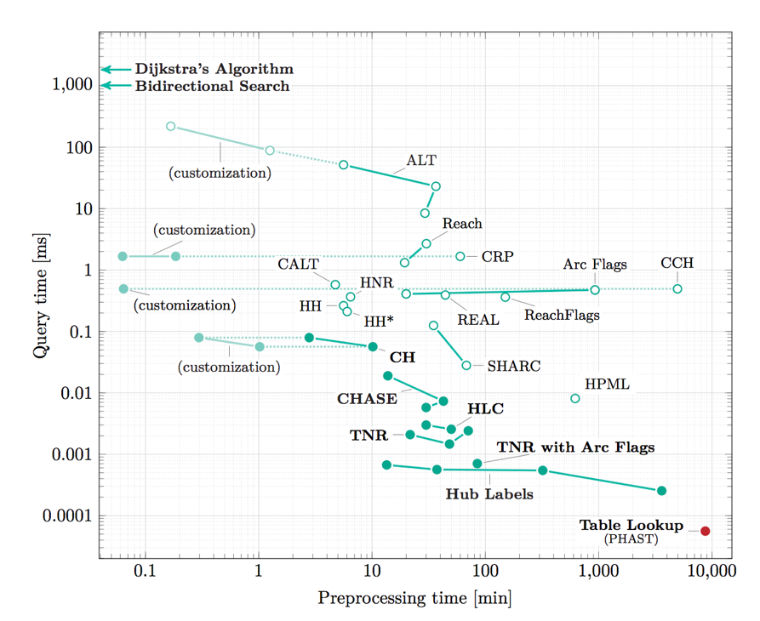

Slide 7
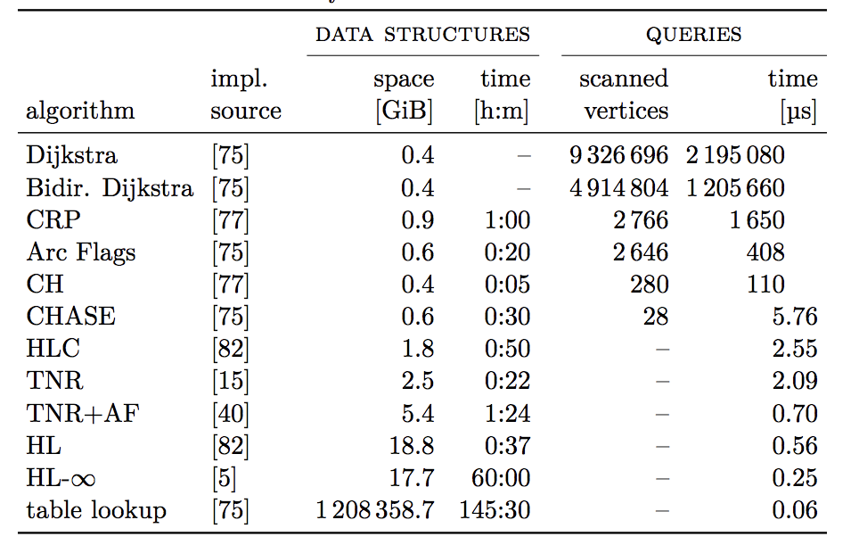

Slide 8
Agenda
Problem Set
Basic Algorithm
Hierarchical technical
Customizable route planning
Q&A

Slide 9
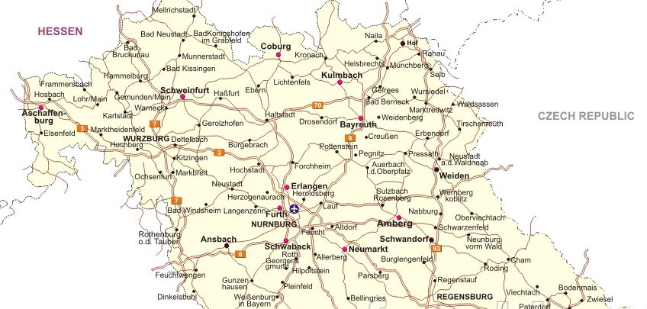
Routing Basic
Unidirectional Dijkstra’s shortest path algorithm

Slide 10
Routing basic
Bi-directional Dijkstra’s shortest path algorithm
Bidirectional search (from Bayreuth and from Erlangen)

Slide 11
Routing basic
Bi-directional Dijkstra’s shortest path algorithm
Bidirectional search (from Bayreuth and from Erlangen)

Slide 12
Agenda
Problem Set
Basic Algorithm
Hierarchical technical
Customizable route planning
Q&A
Notes:
Shortest path between vertices in two faraway regions of the graph tend to use the same major roads

Slide 13
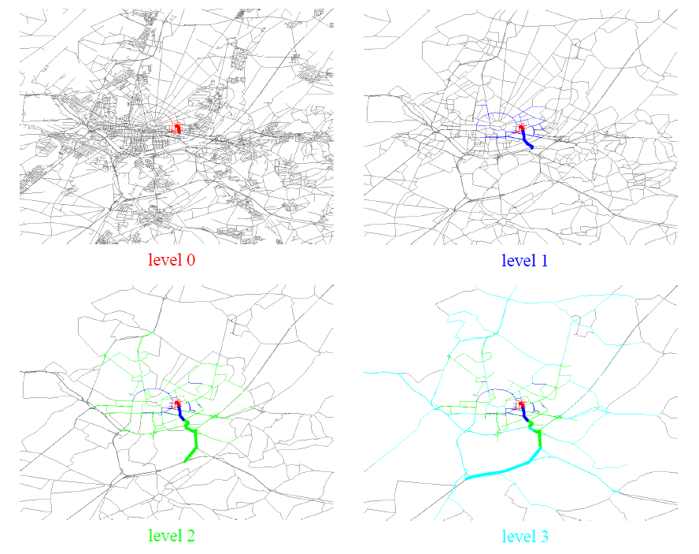
Prune and shrink

Slide 14
Function Class – Attribute based Prune
TME (Telenav, since 2006)
Micro (Telenav, since 2009)
NGX (Telenav, since 2014)
Notes:
5
These roads allow for high volume, maximum speed traffic movement between and through major metropolitan areas. There are very few, if any, speed changes. Access to the road is usually controlled.
4
These roads are used to channel traffic to Main Roads for travel between and through cities in the shortest amount of time. There are very few, if any, speed changes.
3
These roads interconnect FC 4 Roads and provide a high volume of traffic movement at a lower level of mobility than FC 4.
2
These roads provide for a high volume of traffic movement at moderate speeds between neighborhoods. These roads connect with higher Priority to collect and distribute traffic between neighborhoods.
1
These roads' volume and traffic movements are below the level of any other functional class

Slide 15
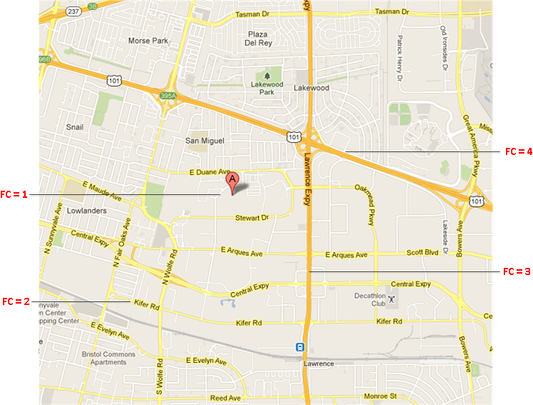
FC – illustration
Notes:
5
These roads allow for high volume, maximum speed traffic movement between and through major metropolitan areas. There are very few, if any, speed changes. Access to the road is usually controlled.
4
These roads are used to channel traffic to Main Roads for travel between and through cities in the shortest amount of time. There are very few, if any, speed changes.
3
These roads interconnect FC 4 Roads and provide a high volume of traffic movement at a lower level of mobility than FC 4.
2
These roads provide for a high volume of traffic movement at moderate speeds between neighborhoods. These roads connect with higher Priority to collect and distribute traffic between neighborhoods.
1
These roads' volume and traffic movements are below the level of any other functional class

Slide 16
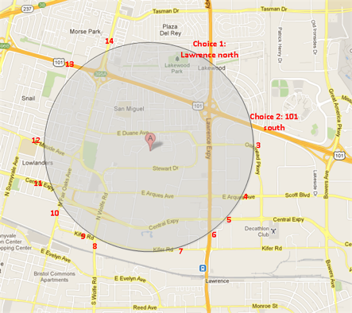
Level promote strategy - Count choices
FC keeps a count of node choices in the priority queue for each level, if the choices after level promotion reach a threshold (current is 40), then it is safe to promote
The choices threshold controls the acceleration of the routing exploration. As it becomes smaller, the exploration gets more accelerated, and the route calculation tends to become faster, but the probability of resulting in a less optimal route also becomes greater.

Slide 17
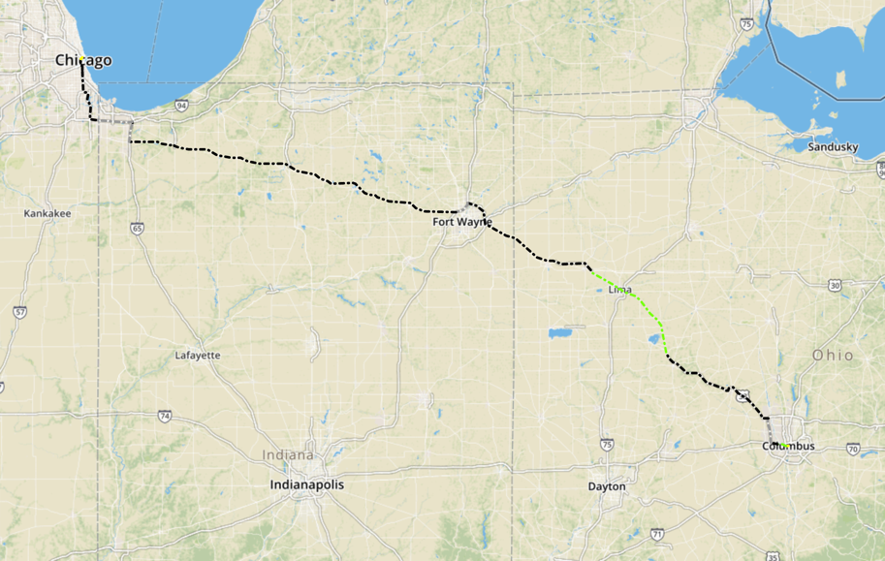
Columbus_to_Chicago avoid toll
Notes:
http://hqd-ssdpostgis-07.mypna.com/webtool/case_viewer.py

Slide 18
Routing’s requirement
Features | Comments
Consider all detail of road network, turns | Yes
Different Metrix(cost function) | Hard to support avoid toll/avoid hwy
Dynamic information(live traffic) | Yes
Traffic jam, user information | Hard to support dynamic broken graph
Performance | Slow
Preprocessing | No
Mathematical correct | No

Slide 19
Highway Hierarchies (HH)
MoRE Server(Telenav, since 2007)
LMoRE (Telenav, since 2008)
Google Maps, (Google, at the time of 2006)

Slide 20
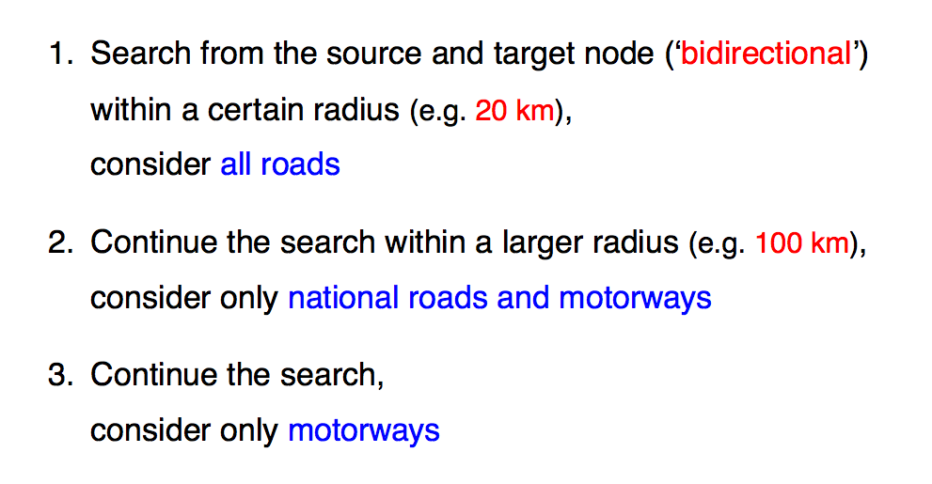
Highway Hierarchies

Slide 21
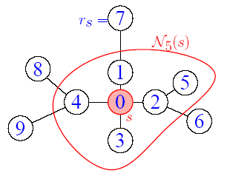
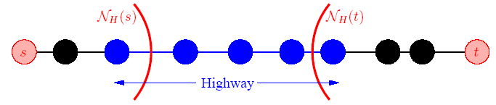
Local vs. Highway
Fig.3 Example of Highway
“Highway” is not the meaning in traditional way, which is just a concept versus “local”
Highway edge is organized in the higher level than local edge
Fig.2 Example of “Local” for node s
“Local” is defined by the Dijkstra rank of the node s with H (H=5)
Notes:
Passive
Abort

Slide 22
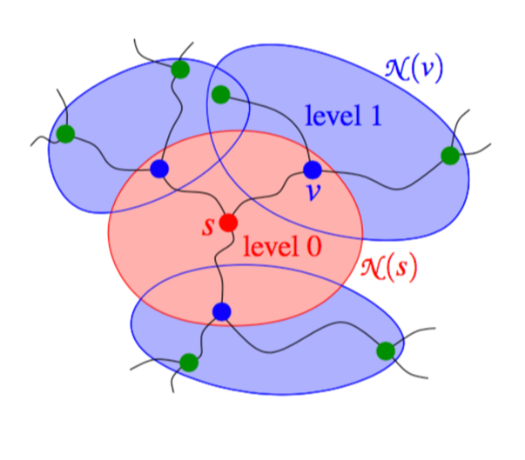
Query

Slide 23
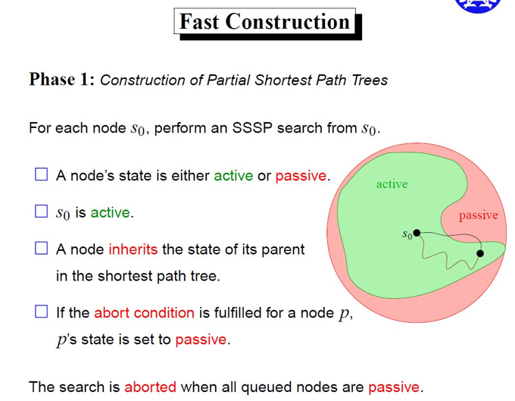
HH

Slide 24
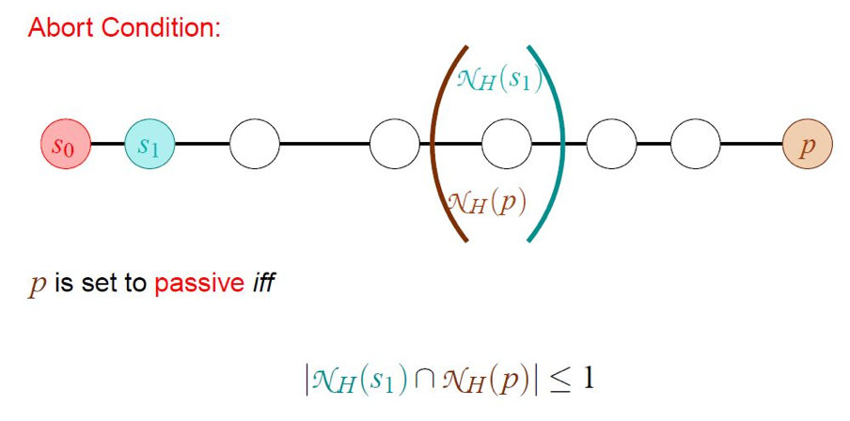
HH Fast construction

Slide 25
Routing’s requirement
Features | Comments
Consider all detail of road network, turns | Yes
Different Metrix(cost function) | Could support avoid toll/avoid hwy
Dynamic information(live traffic) | Yes
Traffic jam, user information | Hard to support dynamic broken graph
Performance | Fast
Preprocessing | Complex
Mathematical correct | Yes

Slide 26
Contraction Hierarchies
GraphHopper
URL: https://github.com/graphhopper/graphhopper
Key word: Java, CH, <<Hidden Markov Map Matching Through Noise and Sparseness>>, OSM
OSRM
URL: https://github.com/Project-OSRM/osrm-backend
Key word: C++, CH, OSM

Slide 27
What is Contraction Hierarchies (CH)?
1-line explain
Highway Hierarchy
Explorer the hierarchical structure of road network by selecting highway
Contraction Hierarchy
Explorer the hierarchical structure of road network by node contraction
Order nodes v₁,...,v_{n} in increasing order of importance
Repeatedly contract unimportant nodes by adding shortcuts required by shortest paths

Slide 28
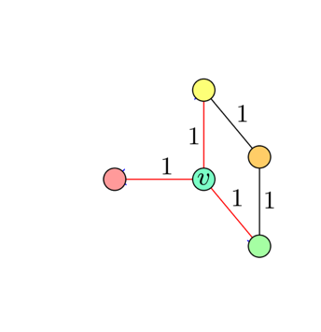
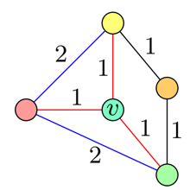
CH basic
Notes:
Passive
Abort

Slide 29
Contraction Hierarchies (A example for compiling)
2
3
2
1
2
2
6
1
4
3
5
Step 1: Use the node-ID as node ordering.
Step 2: Contract node, add necessary shortcut(s).
Repeat the above 2 steps in the below remaining graph.
2
5
1
2
2
6
4
3
5
3
2
1
October 4, 2018
Notes:
Let's have a look on the simplest graph.
White circle is node. Number inside is nodeID.
Arrow represent edges. And the square and number inside represent the cost of the edge. Maybe time or distance.
First we will choose the node-ID as the contract order. We use the height represent the node's order.
When we contract node1, edge <6,1,4> is the shortest path between node 6 and node 4, so we add a necessary shortcuts.
And then node1 and the adjacent edges are invisible for the following preprocess.
This is remaining graph

Slide 30
Contraction Hierarchies (A example for compiling, cont’d)
5
1
2
2
6
4
3
5
2
3
2
1
October 4, 2018
Notes:
Node2 has no inEdge.
So contract node2 will not introduce shortcut.

Slide 31
Contraction Hierarchies (A example for compiling, cont’d)
5
3
6
4
5
2
3
2
1
2
3
2
1
October 4, 2018

Slide 32
Contraction Hierarchies (A example, compiling result)
2
3
2
1
2
2
6
1
4
3
5
6
8
5
5
2
4
3
2
3
2
1
3
2
1
No witness path found
October 4, 2018

Slide 33
Static Contraction Hierarchies – Online Route Computing
Bi-Directional Dijkstra search from source and target 1 by 1
During both searches, nodes can only 'see' the edges lead to higher or equal level nodes.(query relaxes only edges to more “important” nodes)
meet point
6
8
5
5
2
4
3
2
3
2
1
3
2
t
backward search
s
1
forward search
October 4, 2018
Notes:
Bi-Directional upwards-only Dijkstra search from source and target both, until 2 search trees meets, and the tentative path weight is not less than the top nodes' weight in both 2 search trees.

Slide 34
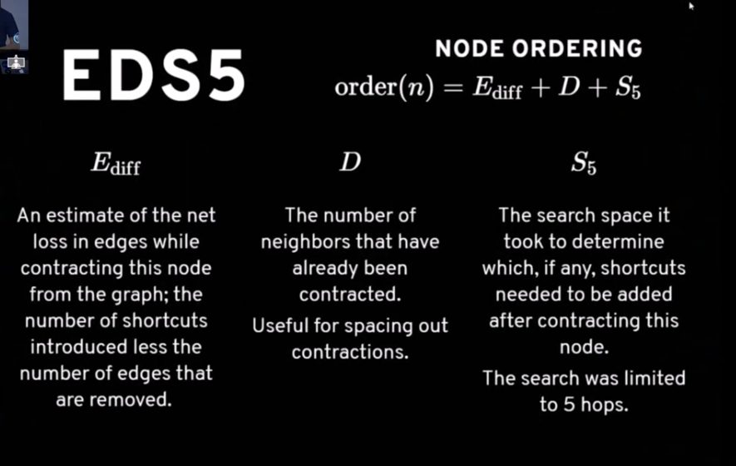
Node Ordering

Slide 35
Routing’s requirement
Features | Comments
Consider all detail of road network, turns | Yes
Different Metrix(cost function) | Could support avoid toll/avoid hwy
Dynamic information(live traffic) | OK
Traffic jam, user information | Could support dynamic broken graph
Performance | Fast
Preprocessing | Simple
Mathematical correct | Yes

Slide 36
Agenda
Problem Set
Basic Algorithm
Hierarchical technical
Customizable route planning
Q&A

Slide 37
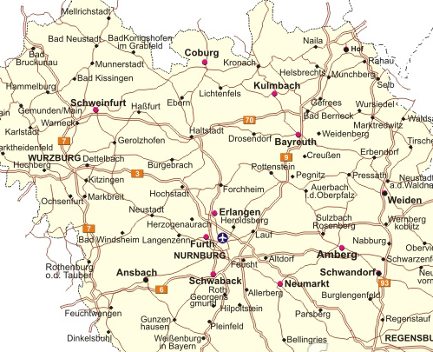
Partition the graph

Slide 38
Partition the graph

Slide 39
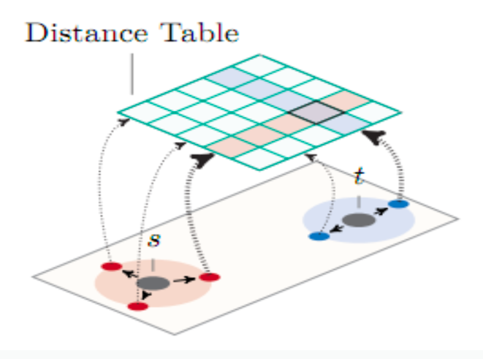

Slide 40
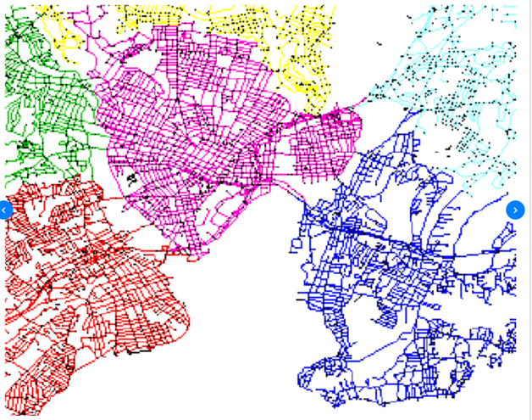
CRP
Step 1: metric independent preprocessing
Graph partition, preprocessing, hours

Slide 41
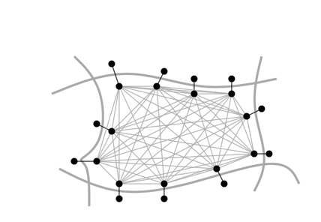
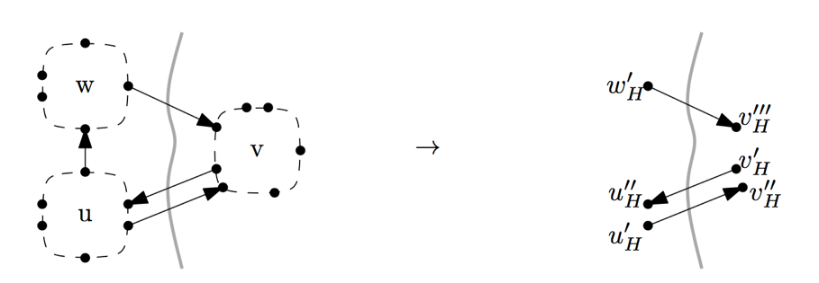

Slide 42
CRP
Step 1: metric independent preprocessing
Graph partition, preprocessing, hours
Step 2: Customization
Apply dynamic information with cost model, each round of traffic update, seconds
Hide all complexity of navigation graph for routing algorithm

Slide 43
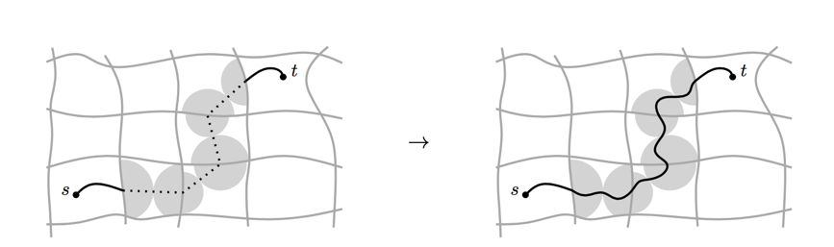
CRP
Step 1: metric independent preprocessing
Graph partition, preprocessing, hours
Step 2: Customization
Apply dynamic information with cost model, each round of traffic update, seconds
Step 3: Query
Real time, per request, mili-seconds

Slide 44
Key idea
Distinction between topological and metric properties of the network
- The topology is the graph structure
- Metric properties means actual cost and dynamic information

Slide 45
Routing’s requirement
Features | Comments
Consider all detail of road network, turns | Yes
Different Metrix(cost function) | Yes
Dynamic information(live traffic) | Yes
Traffic jam, user information | Yes
Performance | Fast
Preprocessing | OK
Can generate mathematical correct route | Yes

Slide 46
Graph partition
The performance of CRP depends heavily on the number of boundary arcs of the underlying partitions
Find balanced - minimum cut is the most important steps

Slide 47
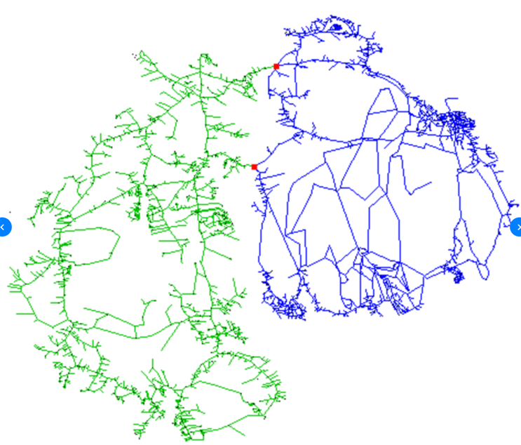
Find min-cut

Slide 48
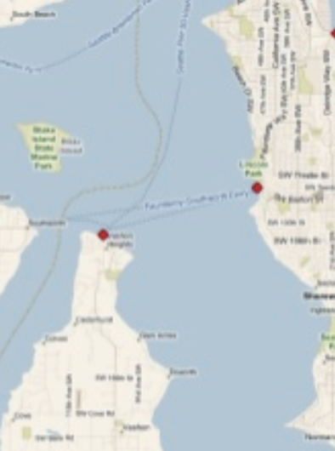
Find Min-cut

Slide 49

Algorithm - Max flow min cut

Slide 50
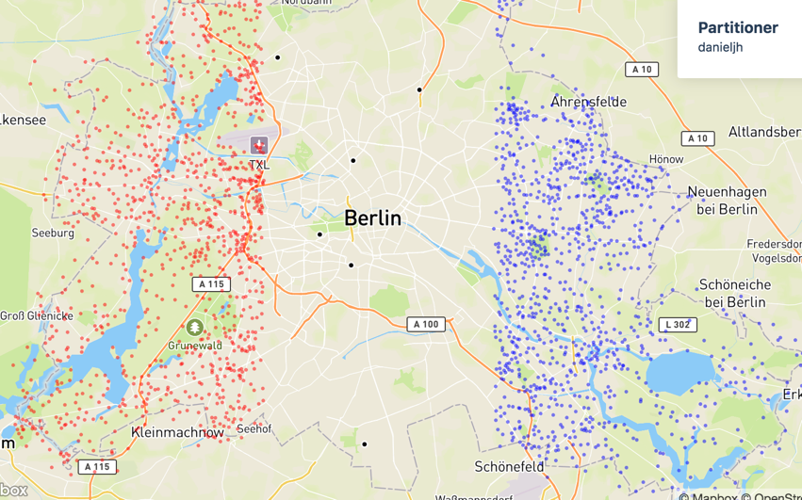
Inertial flow – OSRM

Slide 51
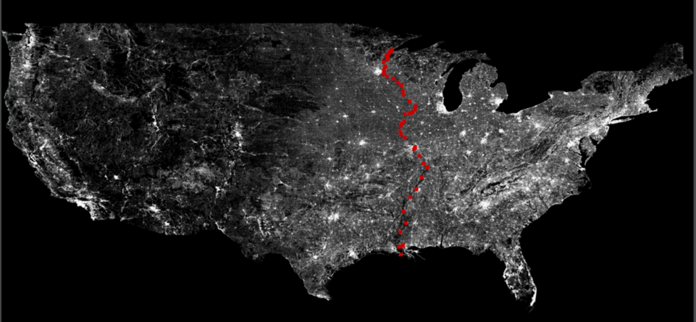

Slide 52
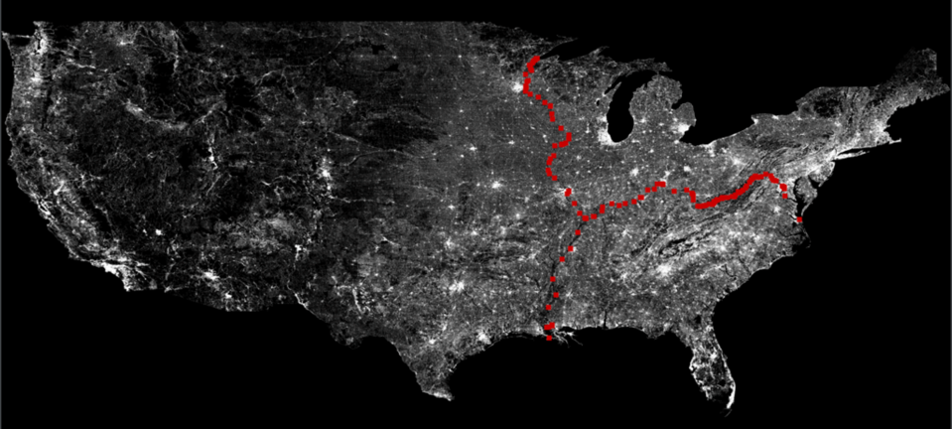

Slide 53
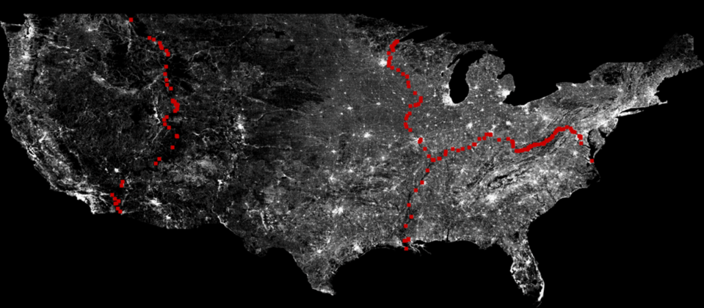

Slide 54
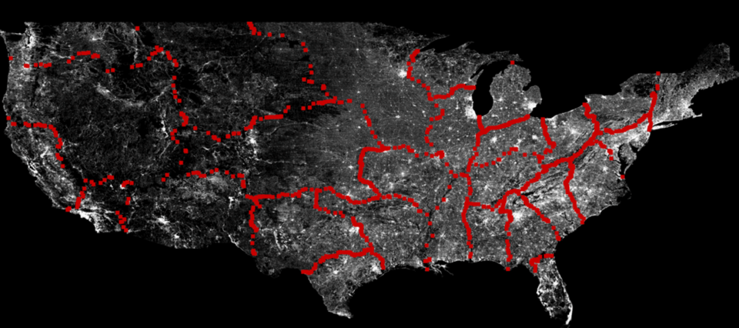

Slide 55
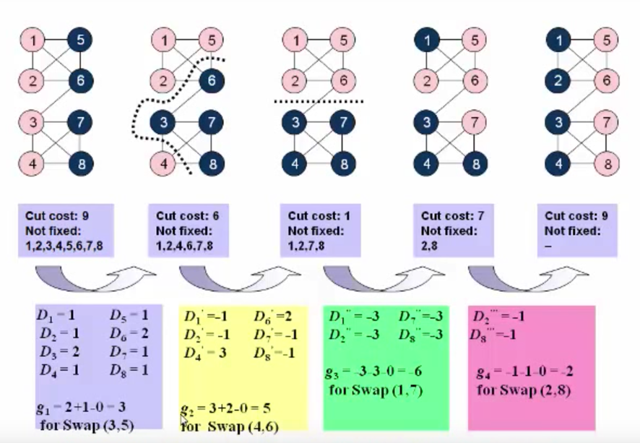
Algorithm - kernighan lin

Slide 56


Slide 57
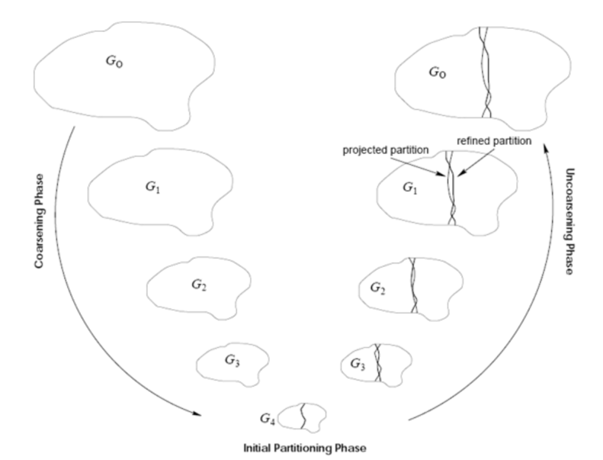
METIS

Slide 58
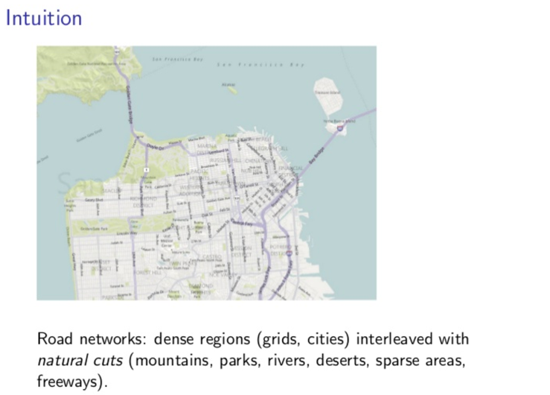
PUNCH – Apple Maps

Slide 59
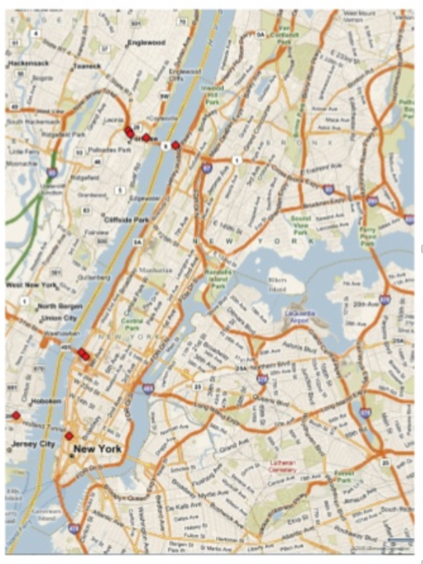

Slide 60
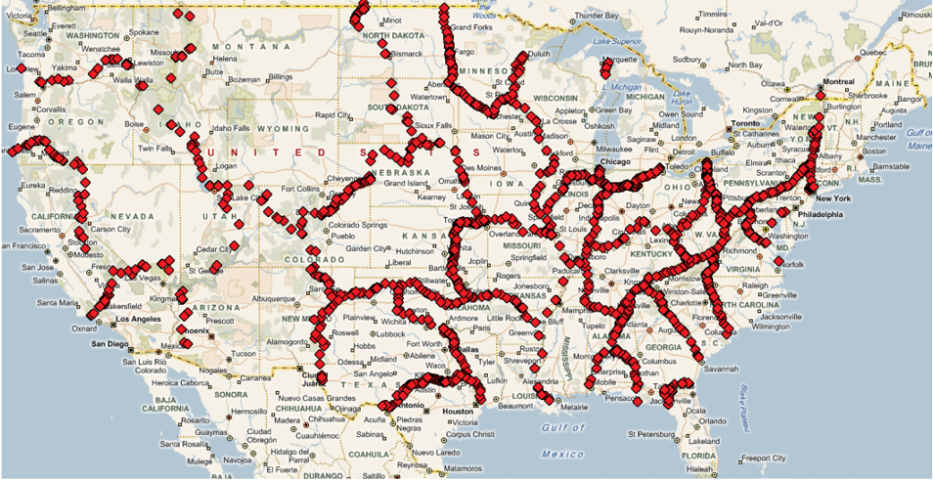

Slide 61
China data – Auto navi
Cell Based Routing
路网分割
提层
路径还原
核心: 按照地级市分割
分层分治
shortcut和策略无关，只和道路结构有关
优点: 更新性能快(秒级更新全国路网)
支持不同的策略
业务灵活(限行规则)

Slide 62
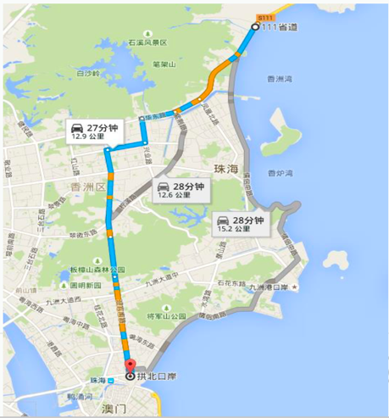
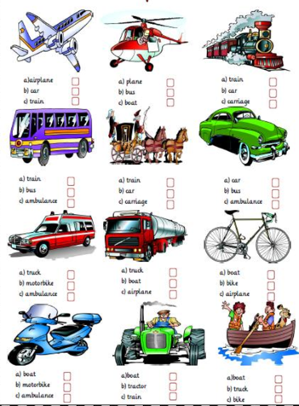
What’s next
Comfortable route

Slide 63
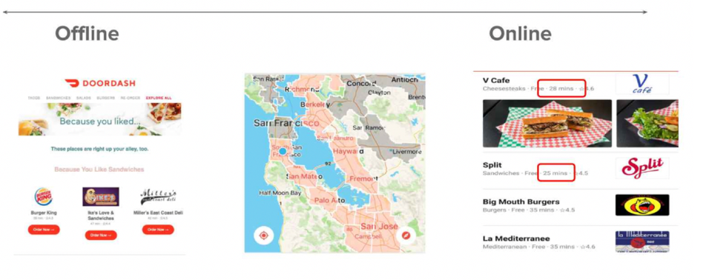
What’s next
Prediction by user data

Slide 64
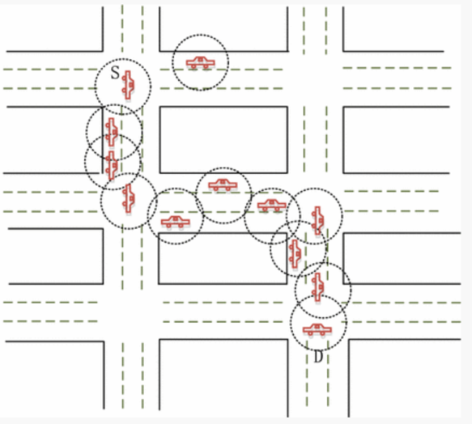
What’s next
Route for automatic car
Notes:
https://link.springer.com/article/10.1007/s11277-018-5642-4

Slide 65
The end, thanks

